Slide 1


Computer-Aided Design Instantiation & Testbench
Mahdi Aminian
Some slides courtesy of:
“Hardware Systems Modeling”, A. Vachoux, EPFL
CAD slides from Dr. Saheb Zamani

Slide 2
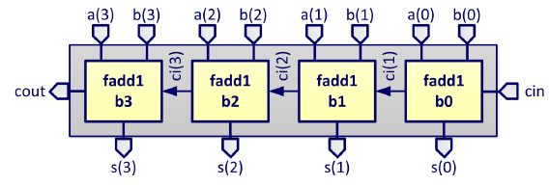
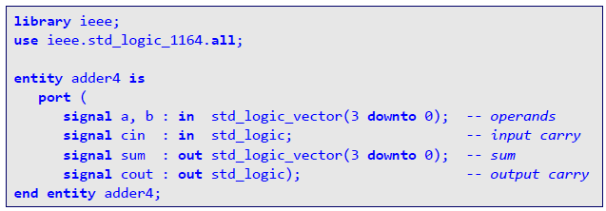
4-bit Ripple-Carry Adder

Slide 3
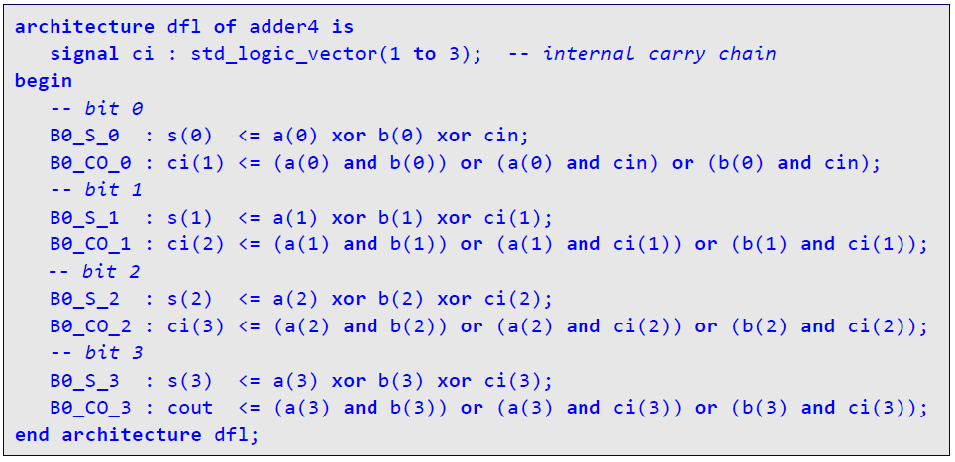

4-bit Ripple-Carry Adder: Dataflow Architecture (1)

Slide 4
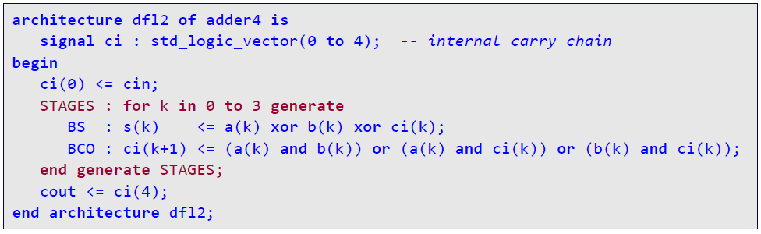
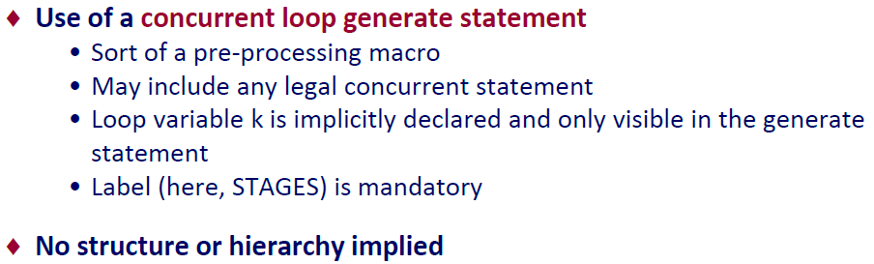
4-bit Ripple-Carry Adder: Dataflow Architecture (2)

Slide 5
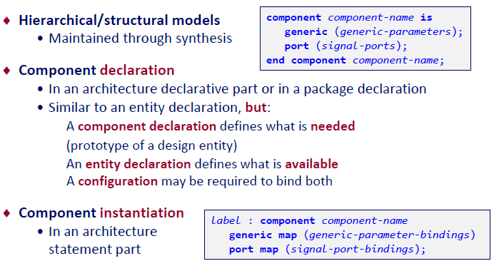

Component Declaration / Component Instantiation

Slide 6
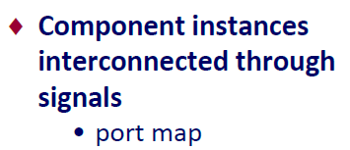
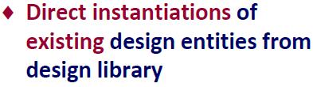

1-Bit Full Adder: Structural Architecture
Architecture Structural of adder4 is signal Ci : std_logic_vector (3 downto 1);
begin
Add0: entity work.fadd1(dfl)
port map (opa=>a(0), opb=>b(0),
cin=>cin, sum=> sum(0),cout=>Ci(1) );
Add1: entity work.fadd1(dfl)
port map (a(1), b(1), Ci(1), sum(1),Ci(2) );
Add2: entity work.fadd1(dfl)
port map (opb=>b(2), opa=>a(2),
cin=>Ci(2), cout=>Ci(3), sum=> sum(2) );
Add3: entity work.fadd1(dfl)
port map (a(3), b(3), Ci(3), sum(3),Cout );
end architecture structural;

Slide 7
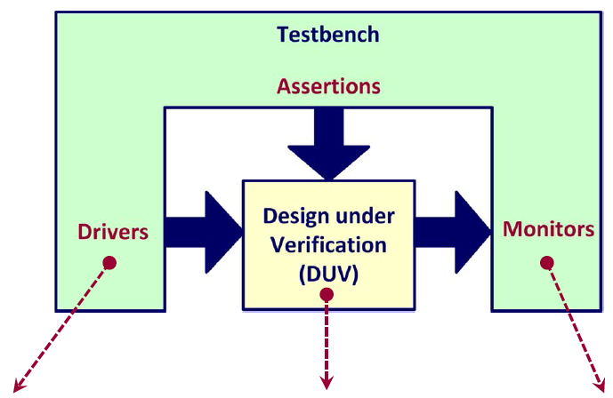
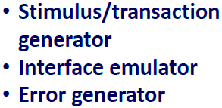
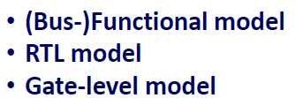
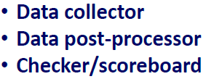
Testbench Model Architecture

Slide 8
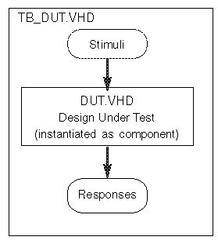
Testbench
VHDL code for top level
No interface signals
Instantiation of design
Statements for stimuli generation
Simple testbenches: response analysis by waveform inspection
Sophisticated testbenches may need >50% of complete project resources

Slide 9
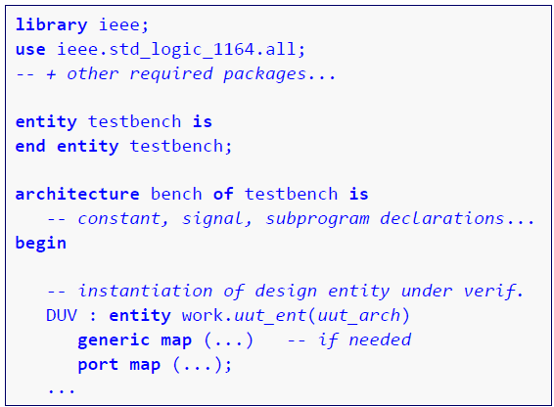
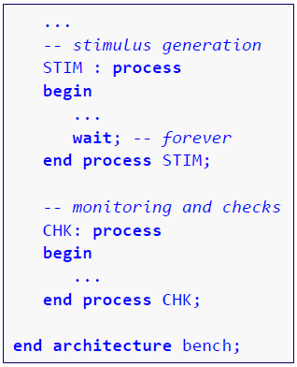
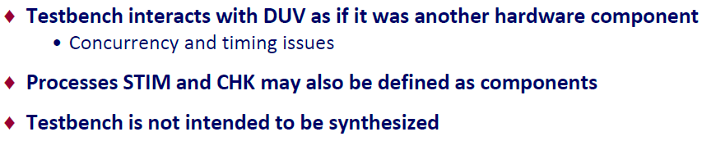
Basic Structure of a VHDL Testbench Model

Slide 10
Simple Testbench Example
entity TB_ADDER IS end TB_ADDER; architecture TEST of TB_ADDER is component ADDER port (A, B: in bit; CARRY, SUM: out bit); end component; signal A_I, B_I, CARRY_I, SUM_I : bit; begin DUT: ADDER port map (A_I, B_I, CARRY_I, SUM_I); STIMULUS: process begin A_I <= ´1´; B_I <= ´0´; wait for 10 ns; A_I <= ´1´; B_I <= ´1´; wait for 10 ns; -- and so on ... end process STIMULUS; end TEST; configuration CFG_TB_ADDER of TB_ADDER is for TEST
for DUT:ADDER use entity work.ADDER(RTL); end for; end CFG_TB_ADDER;
entity ADDER IS port (A,B : in bit; CARRY,SUM : out bit); end ADDER; architecture RTL of ADDER is begin ADD: process (A,B) begin SUM <= A xor B; CARRY <= A and B; end process ADD; end RTL;

Slide 11
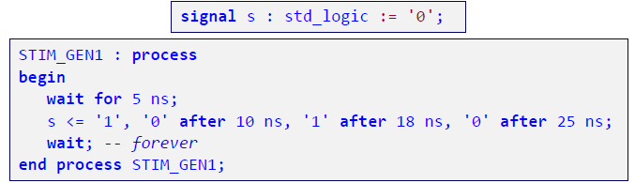
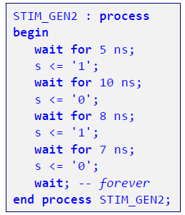
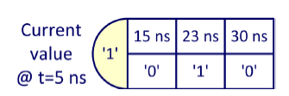
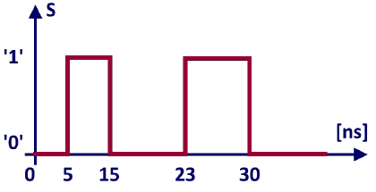
Examples of a Stimulus Generation Process

Slide 12

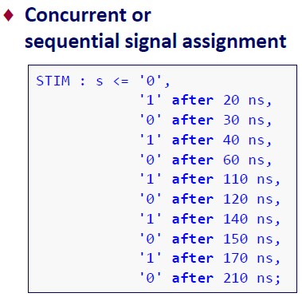
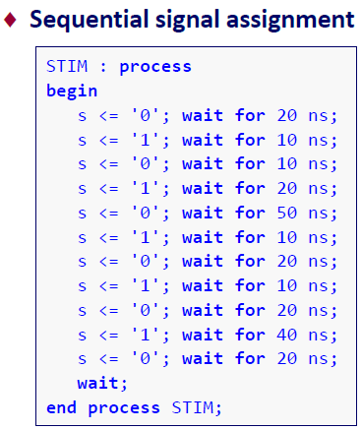
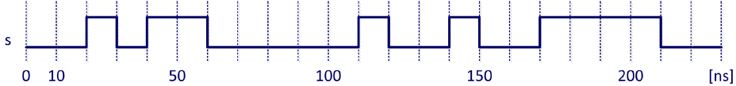
Stimulus: Deterministic Waveform

Slide 13
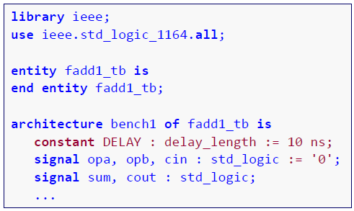
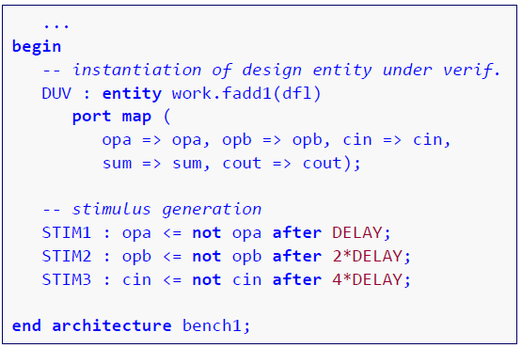


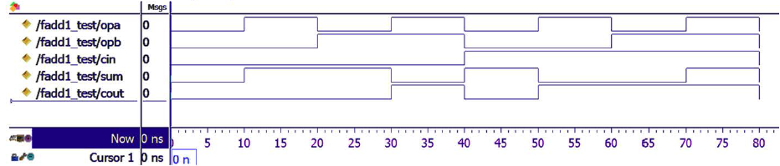
Verification of a Combinational Design Entity

